Slide 1
ENSE 400
Bi-Weekly Scrum Report-Out
t2ee
Zuoxiu Xing
2019/10/18

Slide 2
Project deats
Remind me what you are doing
  What problem(s) are you trying to solve?
    Private servers that are available to students
  What gap are you filling?
    Self-Service Virtual Machine Deployment Platform
  What innovation are you creating?
    Web Page that utilizes Backend API and provides user-friendly interface
Notes:
My project is to create a platform that provide students private linux virtual machines so that they can play with.
For backend, I will use existing software. I had a chat with my mentor Mohmad. He said maybe I should just use existing OpenStack instead of building everything from scratch.
For now I am planning to move to openstack. And I am learning and setting up openstack in my infra.
Custom web interface that utilizes backend API and provides user-friendly interface

Slide 3
Project & documentation review
What are you currently working on?
  Trello
GitHub/Version control “stamp of approval”
  GitHub
Notes:
I manage everything on trello board. It is a Kanban style software.

Slide 4
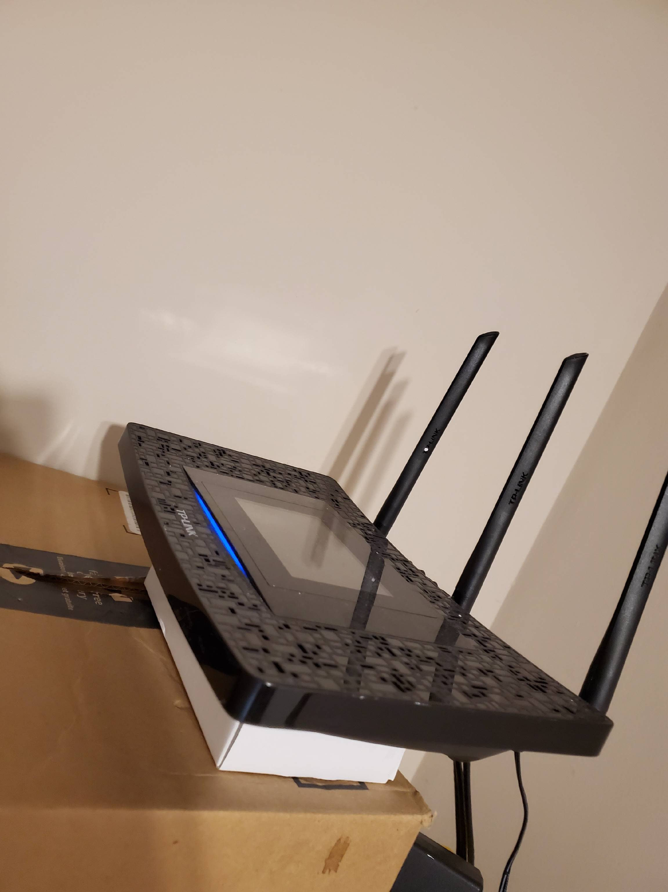
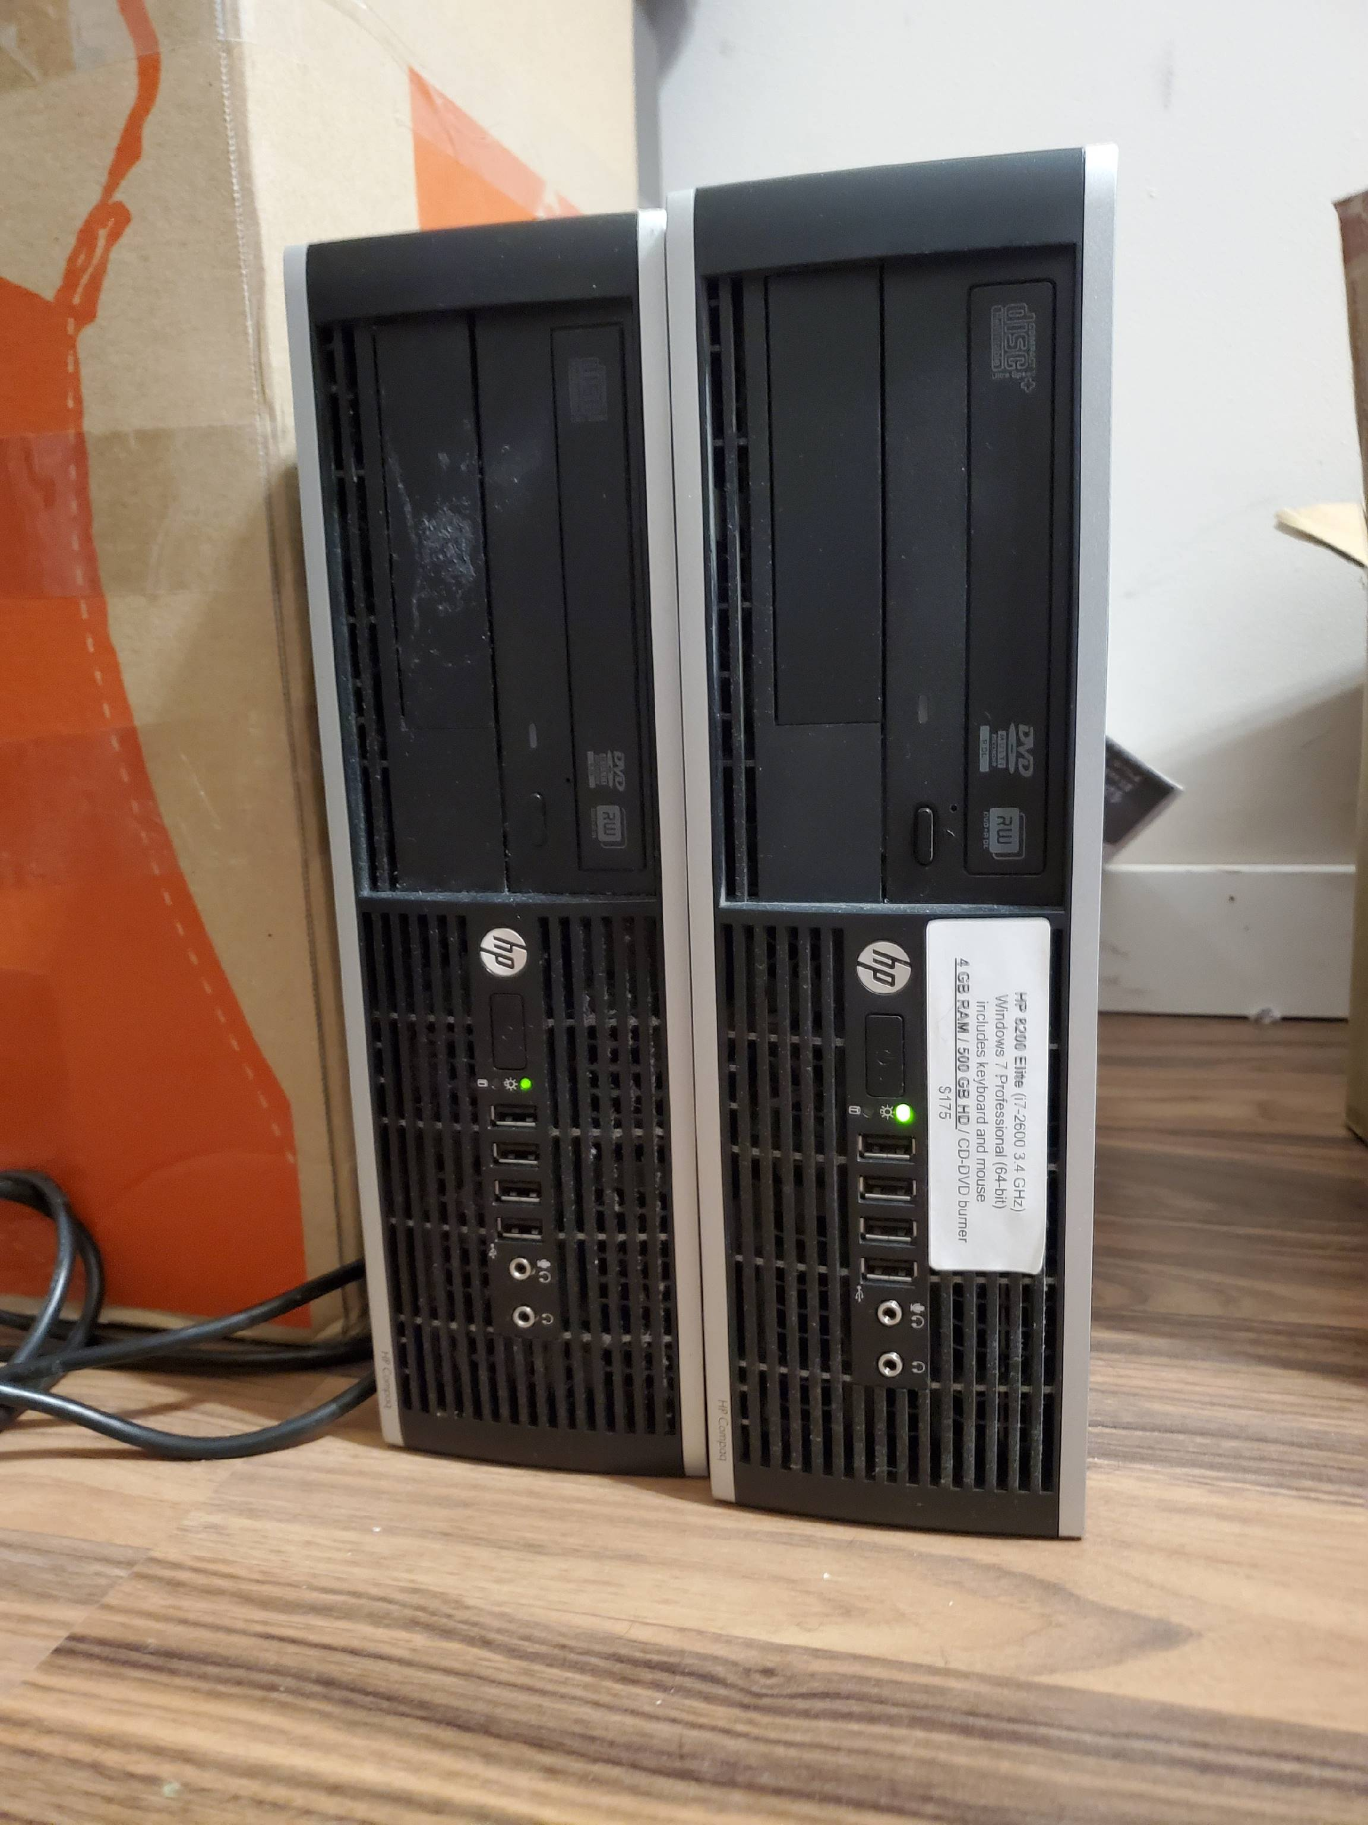
Project demo
Notes:
The router is setup to repeater mode. It will convert wifi to ethernet and provides internet to the pcs.
The two pc on the right, one will be the control node and one will be the compute node

Slide 5
Group reflection
Do you feel you are on track?
  Yes
Do you feel there are barriers to your success (if any)?
  Environment setup
Do you need any help going forward?
  Not at this moment
Any other questions or concerns?
  OpenStack
Notes:
It will take sometime for me to pick up openstack. But I think once it is done. It will actually accelerate my progress.

